Slide 1
Carmel Area Wastewater District
Sea Level Rise Study
Notes:
Thank you for inviting me to participate

Slide 2
1965
Notes:
1965 flood plain map – still relevant today
We’ve been at this location since 1930s

Slide 3
History
Established in 1908 and made it possible for Carmel by the Sea to develop.
In the last 100 years there have been many different configurations at the WWTP.
Design of the 70’s and 80’s took into account floods by elevating structures (1967 flood map).
WWTP operated as designed through two approximately 50-year floods in the 90’s.
Treatment facilities are located approximately 2,500 feet inland from the shoreline

Slide 4
What we do
Treat about
Treat about 1.2 MGD of wastewater everyday, and up to 10 MGD peak during storm events.
Provide
Provide 1 MGD of recycled water to Pebble Beach.
Offset
Offset approximately 1,000-acre-ft per year of water from being drawn from the Carmel River ecosystem (adjudicated basin).
Manage
Proactively Manage Risk to avoid impacts to the public and the environment associated with wastewater.
Seek
Seek opportunities to provide more recycled water.

Slide 5
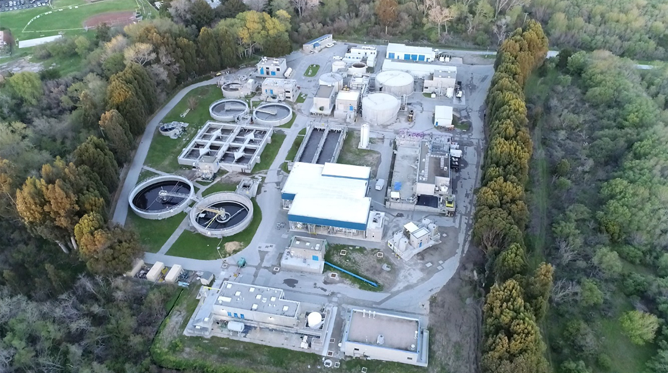

Slide 6
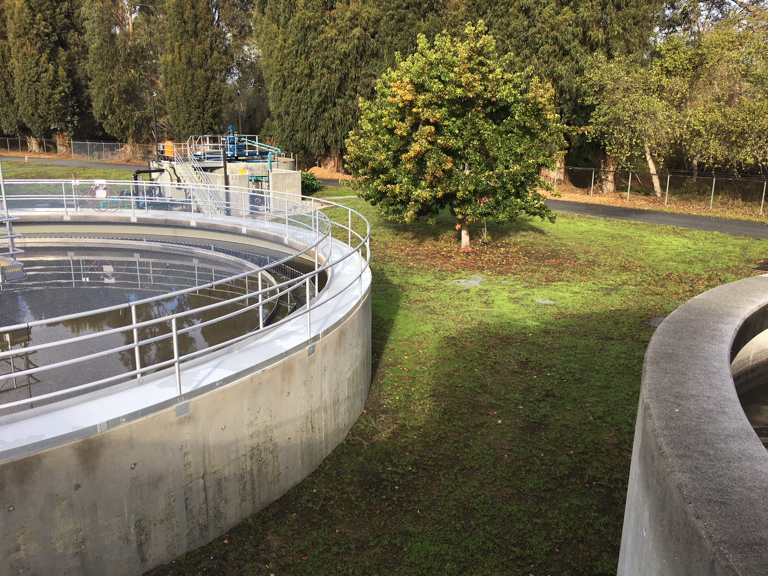
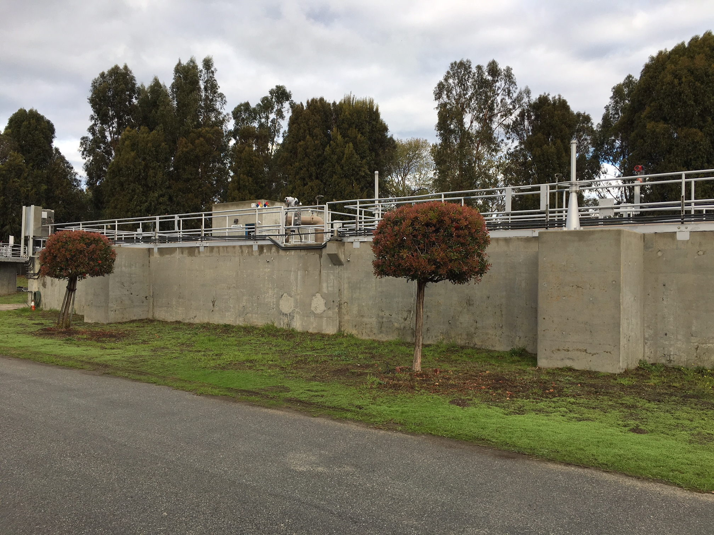
Typical elevated structures

Slide 7
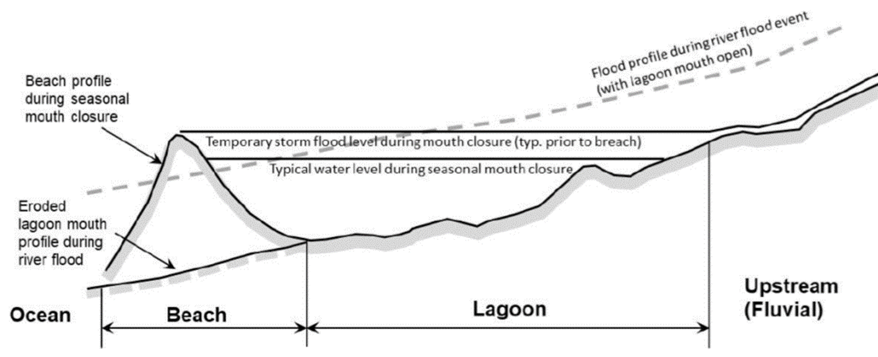
Sea Level Rise Study – Take Aways
Coastal Hazards:
Backwatered Lagoon Inundation
Closed Lagoon Storm Flooding
100-year Fluvial Flooding
Notes:
The Ocean Protection Council (OPC) 2018 was used for guidance on this analysis
The WWTP was evaluated for 3 different scenarios of flooding
Backwatered Lagoon Inundation – a sustained high-water level representative of typical conditions when the lagoon mouth is closed.
Groundwater elevations are likely to equilibrate with this surface water level
Closed Lagoon Storm Flooding – a temp highwater event in the lagoon associated with backup of water when the river mouth is closed and water collects behind the sand bar.
The source of water could be either moderate river streamflow, or wave overtopping into the lagoon. This does not represent extreme fluvial floods
100-yr Fluvial Flooding – during extreme river flow events can cause elevated water levels adjacent to the treatment plant and overtopping of the river channel.
Past flooding has not reached the theoretical 100-year storm levels in historical records.
Although flooding did occur at the plant in the 90s. The probability of a 100-yr storm occurring is 1%
During river flooding events peak water surface elevations at any location depend on the flow rate of the Carmel River

Slide 8
Lagoon Water Levels Over Time For Closed Lagoon Conditions
 | Existing | 2030 | 2050 | 2070 | 2100
Sea Level Rise (feet) | 0 | 1 | 2 | 3 | 6
Backwatered Lagoon Inundation Level (Feet NAVD88) | 11 | 12 | 13 | 14 | 16
Moderate Storm Closed Lagoon Inundation Elevation (feet NAVD88) | 15 | 15.5 | 16 | 17 | 20
Notes:
These two conditions occur when the mouth of the lagoon is closed
The water level does not increase linearly with sea-level rise because the storage of the lagoon expands significantly at elevations greater than 13 feet NAVD
NAVD = North American Vertical Datum of 1988
*This modeling and results implicitly presume that waves and rainfall/runoff are steady (not increased or decreased by climate change) and there is adequate deposition of sand for the beach to rise linearly with sea levels. ESA believes the sand will most likely not rise linearly with sea level rise and therefore the analysis is conservative.

Slide 9
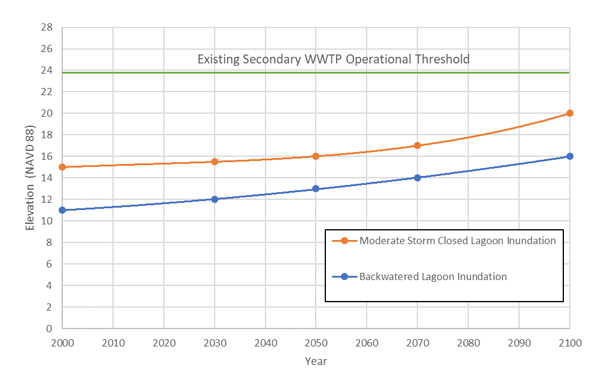
Projections of Lagoon Flooding During Closed Lagoon Conditions Over Time with Sea-Level Rise
Notes:
Presents lagoon water levels for Backwatered Lagoon Inundation & Moderate Storm Closed Lagoon flooding over time with sea-level rise.
Existing condition is assumed to occur at year 2000, consistent with state guidance (CCC2015)

Slide 10
Recent Floods of Record
Year | River Flow (cfs) | Impact to WWTP
March 10th, 1995 | ~16,000 cfs | Water entered treatment plant site. No permit violations.
February 3rd, 1998 | ~14,500 cfs | Water entered treatment plant site. No permit violations
March 11th, 2011 | ~6,000 cfs | No water onsite. No permit violations.
January 9th, 2017 | ~5,500 cfs | No water onsite. No permit violations.
January 11th, 2017 | ~6,700 cfs | No water onsite. No permit violations.
February 21st, 2017 | ~9,200 cfs | No water onsite. No permit violations
Notes:
100-Year Fluvial Flooding assumes that sedimentation in lagoon occurs at same pace as sea level rise. It is believed that sedimentation will be out paced by sea level rise so these numbers are conservative. The availability of sand will be a limiting factor in the ability for the sandbar elevation to increase.
Projections do not include modeling of larger floodplain area created by higher flood elevations. Larger flood plain area would reduce flood elevation at WWTP.
100-year Fluvial Flood elevations are for the Main River Channel on the North East Corner of Treatment Plant. Flood elevations decrease about 2 feet as water moves across the treatment plant.

Slide 11
Sea Level Rise Study – Take Aways
Based worst case on H++ scenario for critical structures.
100-year Fluvial Flood Event is driving factor.
Found that 2062 is the timeframe when critical structures may be substantially impacted by 100-year fluvial flooding under H++ scenario. Used conservative assumptions.
Minor improvements in the near term to increase flood resiliency.

Slide 12
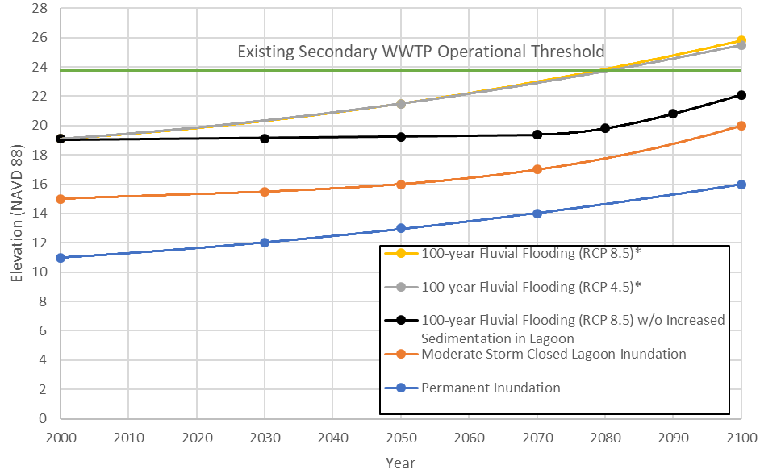
Sea Level Rise Study – Take Aways
Typical Ground Elevation at WWTP
Notes:
100-Year Fluvial Flooding assumes that sedimentation in lagoon occurs at same pace as sea level rise. It is believed that sedimentation will be out paced by sea level rise so these numbers are conservative. The availability of sand will be a limiting factor in the ability for the sandbar elevation to increase.
Projections do not include modeling of larger floodplain area created by higher flood elevations. Larger flood plain area would reduce flood elevation at WWTP.
100-year Fluvial Flood elevations are for the Main River Channel on the North East Corner of Treatment Plant. Flood elevations decrease about 2 feet as water moves across the treatment plant.

Slide 13
Sea Level Rise Study – Take Aways
Conservative in many ways.
  Sedimentation is highly speculative – main source of sediment is Carmel River flowing. Sedimentation seems to be decreasing due to erosive events. (assumed worst case geomorphology)
  As sea level rises the floodplain gets bigger (didn’t model larger hypsometry).
  Used H++ scenario

Slide 14
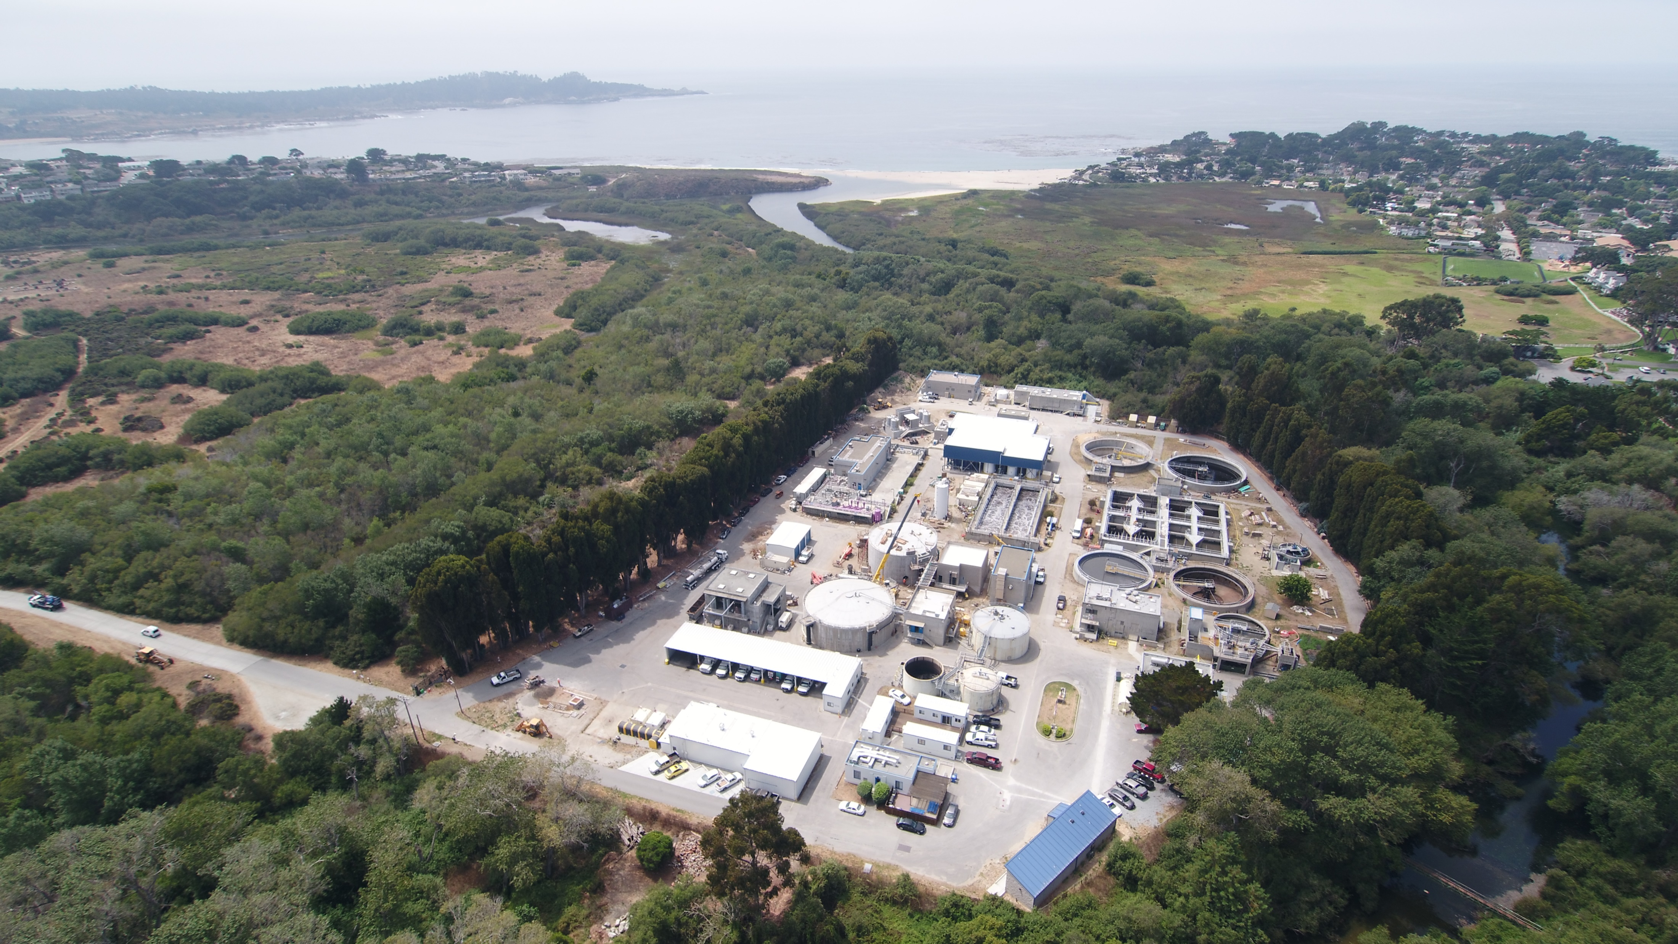
Notes:
More than 2500 feet from the ocean shore

Slide 15
1965
2005

Slide 16
Sea Level Rise Study
CAWD was designed to continue to operate during & after flood events which were known at the time of the design of facilities
According to our study increased storm intensity as well as SLR will not detrimentally effect the plant before the year 2062 under “Extreme Risk Aversion” scenario
Planning for after 40 years
  More climate science will be available.
  Track sea level rise and compare with projections every 5 years.
  Conceptual study of resiliency at higher flood levels vs. relocation of WWTP.
  Allows us time to find a solution.
Notes:
This report assumes that sedimentation at the lagoon sandbar will increase with sea level rise.
If that is not the case it is possible that increases in 100-year fluvial flood levels will not change significantly over the next 50-years.
The projections did not take into account the increased area of the flood plain as flood levels increase.
In reality the increased flooded area will reduce the flood elevations at the WWTP from what is projected
Triggers to move:
Coastal Hazards are adversely affecting the WWTP
The Executive Director is not satisfied with compliance as regards reporting
Long Term Coastal Hazards Plan requires implementation measure to avoid long term coastal hazards
Coastal Hazard Conditions
Coastal Hazard Response
Coastal Hazard Triggers
Regional Effects (i.e. CRFree, EPB, Scenic Road Protective Barrier)
Long Term Coastal Hazards Planning – 2 years

Slide 17

What Ifs
CRFREE
Flood pumping as a water resource
Lagoon management
Notes:
CRFREE – modeling suggests this will reduce the flood elevation by about 1 ft
Estimate 19.1 feet base flood elevation at eastern boundary of WWTP

Slide 18
What we want in a Coastal Development Permit
Master permit to cover regular activities and maintenance work.
Activities that are CEQA exempt (statutory or categorically) are allowed under new CDP.
Continue to utilize Immaterial Amendments for projects that support our ongoing treatment of wastewater and production of recycled water that are not CEQA exempt.
Over next 5 years we will and in 5-year intervals thereafter:
  Develop Monitoring Plan
  Define Trigger Events
  Do Economic Analysis
  Response Plan
  Life Cycle Analysis (already available)

Slide 19
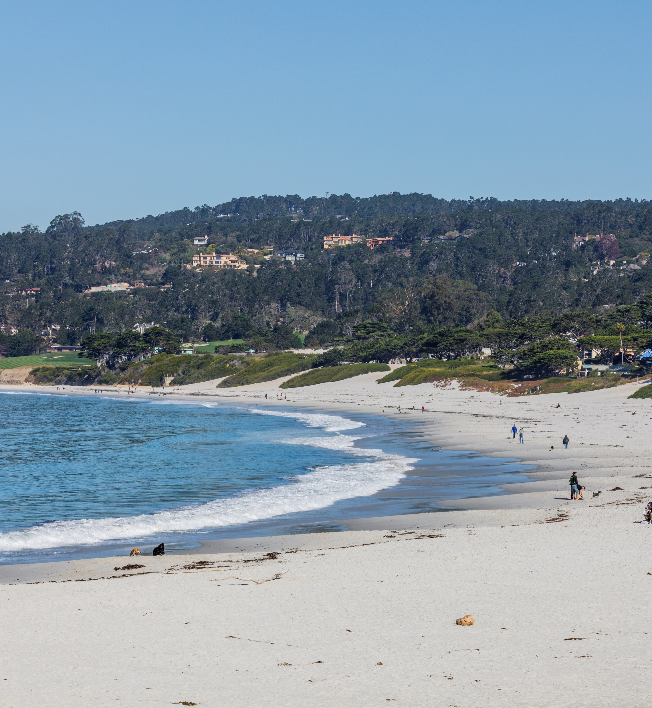
What else?
Treatment plant while our largest asset – is not the only asset susceptible to climate change
We have pump stations at the Carmel Beach and we have significant underground pipeline assets
Our SLR study indicates there will be erosion along Carmel shoreline due to sea level rise and increased storm intensities
When our interests overlap with the City the District would like to join forces to solve the problem

