Slide 1
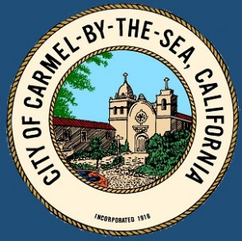
Warming Up for the Fight Against Climate Change
CITY OF CARMEL-BY-THE-SEA
Committee Members <names>
Presentation to <Organization>
<Date>

Slide 2
CITY OF CARMEL-BY-THE-SEA
Today’s Presentation
Origins and Organization of the Carmel Climate Change Committee
Accomplishments to date
Where we are now
Future goals and objectives
Underlying everything: COVID-19

Slide 3
m
CITY OF CARMEL-BY-THE-SEA
Origins and Organization of the Carmel Climate Change Committee
Project money allocated in 2019/2020 Budget
(De-allocated this past June. ☹)
City Council resolution in August 2019
2 Council members – Jeff Baron and Carrie Theis
4 members of the public
John Hill, Michael LePage, Scott Lonergan, LaNette Zimmerman
2 staff members
Agnes Martelet, Evan Kort

Slide 4
CITY OF CARMEL-BY-THE-SEA
The two halves of Carmel’s Climate Plan
Adaptation – Make plans to best adapt to the changing climate
… protect assets (natural and man made) from the effects of climate change
Action – Reduce Greenhouse gases
… from the generation of electricity
… from the usage of natural gas
… from transportation

Slide 5
CITY OF CARMEL-BY-THE-SEA
Mission Statement
We will assess the threats and challenges of climate change as they relate to our community by seeking input from experts and local constituents. We will use these inputs to develop actionable plans to mitigate those threats and educate the community.

Slide 6
CITY OF CARMEL-BY-THE-SEA
Accomplishments to Date
Hazards and Assets
Greenhouse Gas Inventories (Data)

Slide 7
CITY OF CARMEL-BY-THE-SEA
Hazards: Things that will happen as a result of climate change
Sea Level Rise
Larger Storms
Warmer Weather
Assets: Things that will be affected by the hazards
Wastewater treatment plant
Private Property
Health of community members

Slide 8
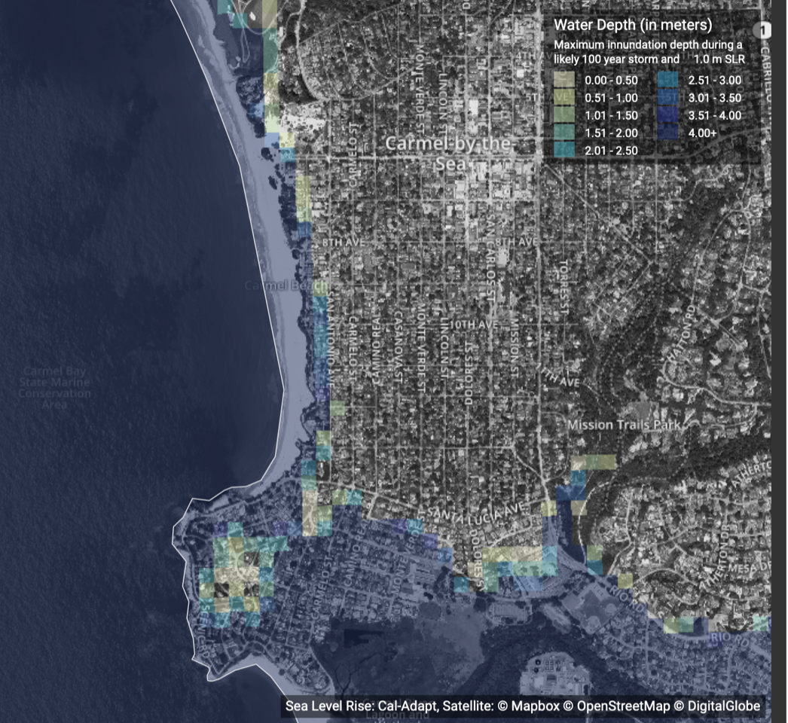
CITY OF CARMEL-BY-THE-SEA
Hazard: Sea Level Rise
Maximum inundation with a 100-year storm with (only) 1 meter of Sea Level Rise. Assets at risk:
Seawalls
Homes up to San Antonio Road in some places – about 75 homes
Sewer Lines
CAWD (Wastewater Plant)

Slide 9
CITY OF CARMEL-BY-THE-SEA
Reminder slide
On the next two slides, Be sure to cover assets that are important to the audience. Spend time on them.
CAWD – wastewater pipes, treatment plant
Friends of the Forest – tree selection
Carmel Residents Association – Public Safety (electrical grid resiliency, for example.)

Slide 10
CITY OF CARMEL-BY-THE-SEA
Hazards and Assets
Priority Assets at Risk | Priority Hazards
 | Sea Level Rise | Wildfires | Stronger Storms & Higher Windspeeds | More Variable Rainfall | Increased Temperature
Natural Assets
Mission Trail Nature Preserve |  | X | X | X | X
North Dunes | X |  |  | X | X
Urban Forest |  | X | X | X | X
Marine Sanctuary |  |  | X | X | X
Carmel Beach | X |  | X
Community
Persons with disabilities |  | X | X | X | X
Elderly Population |  | X | X | X | X
Visitors | X | X | X
Local Businesses | X | X | X |  | X
Utilities
Water Supply (Drought Tolerance) |  | X |  | X | X
Electrical Energy Transmission (Electric Vehicles, safety power shutoffs, outages) |  | X | X |  | X
Sanitary Sewer System | X |  |  | X
PG&E underground infrastructure | X | X
Storm drainage system | X |  | X | X

Slide 11
CITY OF CARMEL-BY-THE-SEA
Hazards and Assets
Priority Assets at Risk | Priority Hazards
 | Sea Level Rise | Wildfires | Stronger Storms & Higher Windspeeds | More Variable Rainfall | Increased Temperature
Regional Infrastructure
Wastewater Treatment Facility | X |  | X | X | X
Transportation Infrastructure | X | X | X | X
Hospital and emergency medical care facilities |  | X | X |  | X
Landfill & Waste Management |  |  | X | X
Local Infrastructure
Scenic coastal trail, public restrooms and beach access infrastructure | X | X | X | X | X
Coastal roadways and parking | X |  | X | X | X
Seawalls and revetments | X |  | X | X
Other city streets |  |  | X | X
Private property (including many second homes) | X | X | X | X | X

Slide 12
CITY OF CARMEL-BY-THE-SEA
Carmel Greenhouse Gas Inventories
Community Emissions by Sector | Residential | Commercial / Industrial | Transportation | Solid Waste | Wastewater | Total
2005 | 12,336 | 10,468 | 14,844 | 3,036 | 76 | 40,760
2010 | 13,060 | 10,618 | 14,662 | 1,639 | 72 | 40,051
2015 | 9,687 | 8,001 | 8,169 | 1,527 | 74 | 27,458
% change 2005- 2015 | -21% | -24% | -45% | -50% | -3% | -33%

Slide 13
CITY OF CARMEL-BY-THE-SEA
Energy Use Emissions (2015)
Emissions Source | Natural Gas Use: |  | Electricity Use: |  | Combined
Sector | Commercial/Industrial | Residential | Commercial/Industrial | Residential | Across Sectors
CO₂e (metric tons) | 7,194 | 5,073 | 2,493 | 2,928 | 17,688
% of Total Energy Use | 41% | 29% | 16% | 14% | 100%
*The transportation, solid waste and wastewater sector are excluded from this analysis

Slide 14
CITY OF CARMEL-BY-THE-SEA
Where we are right now (or where were we back in March?)
Getting Back on Track!
Revamping the project plan – Time delay and Money shortage
Community Outreach
Partner Organizations – PG&E, CAWD, etc.
Schools
Community events (Farmers’ markets, fairs, etc.)
City Meetings
Bring Greenhouse Gas Inventories up to date

Slide 15
CITY OF CARMEL-BY-THE-SEA
What’s in the Future?
Prioritization of Hazards and Assets
What are the most important actions for the city to take to protect the community and the (natural and built) environment?
Set Emissions (Greenhouse Gas) Targets
Then… Define strategies for determined goals
Then… Develop workplan to implement strategies to achieve goals, measuring objectives along the way

Slide 16
CITY OF CARMEL-BY-THE-SEA
Prioritizing Hazards and Assets
Priority Assets at Risk | Priority Hazards
 | Sea Level Rise | Wildfires | Stronger Storms & Higher Windspeeds | More Variable Rainfall | Increased Temperature
Natural Assets
Mission Trail Nature Preserve |  | X | X | X | X
North Dunes | X |  |  | X | X
Urban Forest |  | X | X | X | X
Marine Sanctuary |  |  | X | X | X
Carmel Beach | X |  | X
Fire fuel reduction
Minimal effort, volunteers
But… Need to keep on top of it!
Timeframe: short
Tree species palette
Inexpensive, but…
50 year time horizon but must start soon!
Timeframe: Medium
Seawall armoring?
Politically Difficult
Expensive
50 year time horizon
Timeframe: Long

Slide 17
CITY OF CARMEL-BY-THE-SEA
Prioritizing Hazards and Assets (Continued)
Priority Assets at Risk | Priority Hazards
 | Sea Level Rise | Wildfires | Stronger Storms & Higher Windspeeds | More Variable Rainfall | Increased Temperature
Utilities
Water Supply (Drought Tolerance) |  | X |  | X | X
Electrical Energy Transmission (Electric Vehicles, safety power shutoffs, outages) |  | X | X |  | X
Sanitary Sewer System | X |  |  | X
PG&E underground infrastructure | X | X
Storm drainage system | X |  | X | X
Water Supply
Can we have a more resilient and flexible water supply?
Politically charged regional issue
Timeframe: Moderate
Sanitary Sewer
Expensive, significant planning
Long time horizon.
Very important, but not our jurisdiction!
Timeframe: Long
Electrical Transmission (planned outages due to fire danger)
May get worse in the future
Generally, not within our control… but can we mitigate locally?
Timeframe: Moderate
PG&E Undergrounding
Expensive, but not… maybe not… necessary?
30 year time horizon once we start
Timeframe: Short to Never

Slide 18
CITY OF CARMEL-BY-THE-SEA
Carmel Greenhouse Gas Inventories
Community Emissions by Sector | Residential | Commercial / Industrial | Transportation | Solid Waste | Wastewater | Total
2005 | 12,336 | 10,468 | 14,844 | 3,036 | 76 | 40,760
2010 | 13,060 | 10,618 | 14,662 | 1,639 | 72 | 40,051
2015 | 9,687 | 8,001 | 8,169 | 1,527 | 74 | 27,458
2030, -40% change from 2005 (-11% from 2015) | 7,401 | 6,281 | 8,906 | 1,821 | 46 | 24,456

Slide 19
s
CITY OF CARMEL-BY-THE-SEA
Reaching Emissions Targets
Emissions Source | Natural Gas Use: |  | Electricity Use: |  | Combined
Sector | Commercial/Industrial | Residential | Commercial/Industrial | Residential | Across Sectors
CO₂e (metric tons) | 7,194 | 5,073 | 2,493 | 2,928 | 17,688
CO₂e (2030) | 6,402 | 4,515 | 2,244 | 2,606 | 89%
*The transportation, solid waste and wastewater sector are excluded from this analysis

Slide 20
CITY OF CARMEL-BY-THE-SEA
Define Strategies for determined goals
Frist, learn from work that other jurisdictions already completed:
Understanding seawall conversations
Planning for electrical grid resiliency
Low lying wastewater pipes and treatment plants
Building code adaptations
Limits on usage of natural gas

Slide 21
CITY OF CARMEL-BY-THE-SEA
Define Strategies for determined goals (continued)
Then, develop strategies that are unique to Carmel
Urban forest species selection
Stormwater runoff
Effects on tourism

Slide 22
CITY OF CARMEL-BY-THE-SEA
This slide could be specific for the presentation
(CAWD) How will be manage the sewer lines?
Will we need punnp stations?
Is the plant safe in the river mouth?
(PGE) How will we manage grid resiliency? What are the issues that are specific to Carmel?
(Landwatch) Transportation and GHG Inventories
How can we reduce transportation of visitors and employees into and out of the downtown?

Slide 23
CITY OF CARMEL-BY-THE-SEA
Finally! Put it all together into a workplan
Important to:
Set objectives to measure progress towards a goal
Eg: Come to agreement with CAWD regarding rerouting sewer lines
Eg: In 10 years, show progress on tree selection
Eg: What should our greenhouse gas emissions be in 2030?
Continue public outreach
Revisit the plan on a recurring basis. Re-evaluate hazards and assets. This is a task that will be with us forever!
Get City Council Blessing. Make it a priority.

Slide 24
CITY OF CARMEL-BY-THE-SEA
Questions?

